Slide 1


White Balance under Mixed Illumination using Flash Photography
Zhuo Hui
Aswin C. Sankaranarayanan
Kalyan Sunkavalli
Sunil Hadap
Notes:
Thanks for coming,
Today, I would like to talk about flash photography technique in solving the white balance problem.

Slide 2
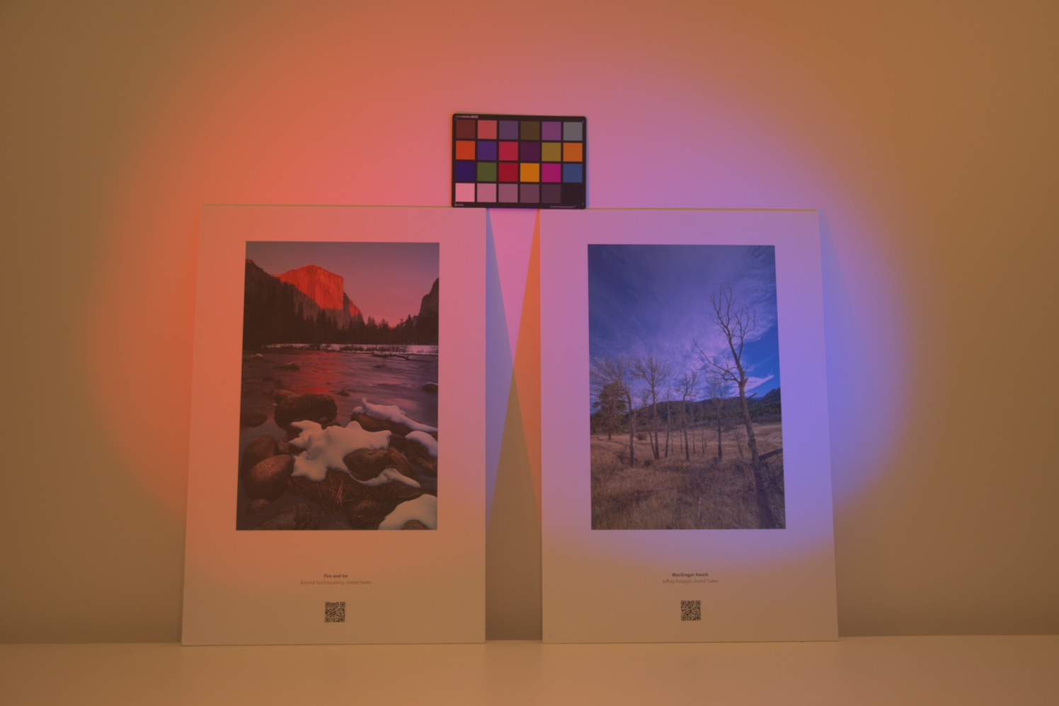
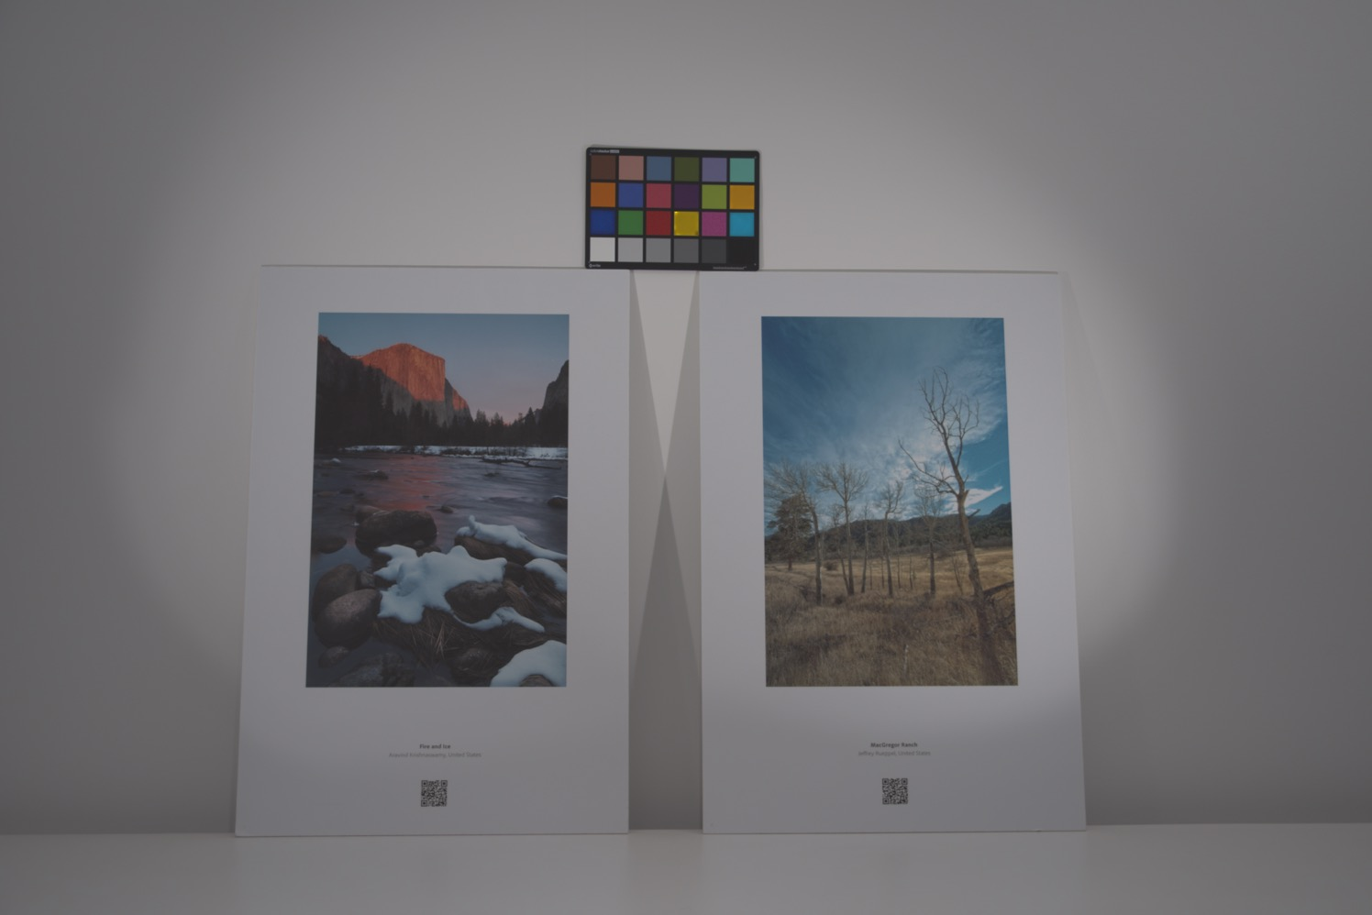
White balance
Notes:
To begin with, let’s first look at what white balance is .
%
All of you may have such experience when taking photographs, the colors of the photograph are affected by the color of the illuminant.
%
Now, let’s look at this example, which have illuminated by three light source. LED in the right, Lamp in the right, and fluroncent light in the middle.
%
You can clearly see the color difference introduced by the illuminants.
%
But such kind of effects is not desirable since it may put another layer of difficulties for most of the per-pixel techniques in graphic and visions.
%
So, the white balance techniques come up to address this issue.
%
Or we can say that , the white balance is to remove light color cast introduced by the illuminant. %
%
What we have enabled in this work is a closed form solution for arbitrary number of illuminants in the scene.
%

Slide 3

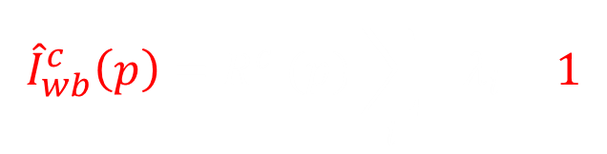

Image formation
Assumption: The scene is Lambertain
$$I^{c}\left(p\right)=R^{c} (p)\sum_{i}{{ λ}_{i} l_{i}^{c}}$$
albedo
light color
shading
$${\hat{I}}_{wb}^{c}\left(p\right)=R^{c} (p)\sum_{i}{{ λ}_{i} 1}$$
$=W^{c} (p)$ ${ I}^{c}\left(p\right)$
White balance kernel
Notes:
To see how it works, we first formulate the problem with some math.
%
Under the Lambertain assumption, you can write down the intensity observed at a particular pixel p as follows:
% Here, denote the surface normal associated with p as n, and denote each light source in the scene with intensity scaled direction s, and color chromaticity l.
%
Since the white balance is to make the light color term being a constant across the color channel, we can write the image formation equations
%
What you need to solve is to find a kernel W such that the color of the image solely depends on the color of the reflectance.
%
Now, since the chromaticity of the albedo is the same as the chromaticity of the white balanced image, we can also put the problem as follows:
%
In which we would like to find a per-pixel kernel to convert the chromaticity of no-flash to the chromaticity of the albedo.
%

Slide 4




Color chromaticity
${\hat{I}}_{wb}^{c}\left(p\right)=W^{c} (p)$ ${ I}^{c}\left(p\right)$
$$C^{c} \left(p\right)=\frac{I^{c}\left(p\right)}{\sum_{c}{I^{c}\left(p\right)}}$$
$C_{wb}^{c}\left(p\right)=\frac{R^{c} (p)\sum_{i}{ λ_{i}}}{\sum_{c}{R^{c} (p)\sum_{i}{λ_{i}}}}$ $=\frac{R^{c} (p) }{\sum_{c}{R^{c} (p) }}$ = $C_{R}^{c}\left(p\right)$
$$C_{R}^{c}\left(p\right)=W^{c}(p)C^{c} \left(p\right)$$
Chromaticity of albedo
Chromaticity of image intensity
Notes:
This directs us to the following relation.
%
That is, we would like to solve for the white balance kernel, which can convert the chromaticity of the intensity observed to the chromaticity of the albedo.
%
The question here is can we do it easily or not.

Slide 5

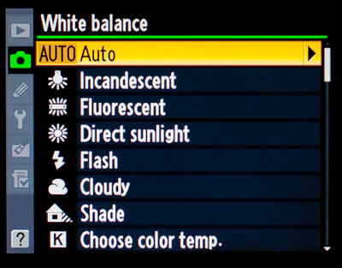
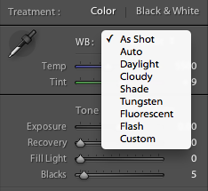


Challenges
$$I^{c}\left(p\right)=R^{c} (p)\sum_{i}{λ_{i}l_{i}^{c}}$$
Multiple illuminants
$$I^{c}\left(p\right)=R^{c} (p)λ l^{c}$$
Single illuminant
Gijsenij et al., Improving color constancy by photometric edge weighting, PAMI, 2012
Notes:
The key challenge here is how to determine the color of the albedo.
%
In particular, from the intensity only, it is very hard to tell the colors we observed are attributed by the albedo or by the light sources.
%
There are huge ambiguities we cannot resolve.
%
What people have done in the past is to assume certain things and incorporate more constraints.
%
A common assumption made is by assuming only one dominant light in the scene.
%
So, under this assumption, the problem can be greatly simplified.
%
If we have prior knowledge on the color of the light source, the problem can be solved in one shot.
%
This facilitates numerous commercial applications in solving white balance problem.
%
By selecting the light source type, a pre-computed light color is e used to solve the problem
%
But what if the scene is complex and cannot be simply modeled with one dominate light source.

Slide 6
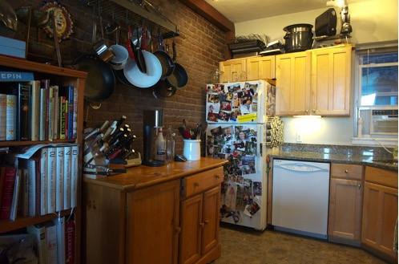
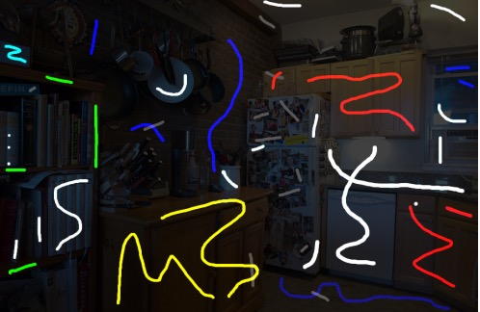
User guidance
Boyadzhiev et al., User-guided white balance for mixed lighting conditions, TOG, 2012
Notes:
To account for this, past works seek for the help from the users.
%
The users require to provide feedbacks of the scene property, like the regions shud look like white color, regions under single light source.
%
Users use scribbles to indicate these regions as the example shown here.
%
By doing this, more constraints can be incorporated to constrain the underlying ill-posed problem.
%
However, the user-guidance approach requires considerable effort as well as the expertise of the users to give valuable feedback.

Slide 7
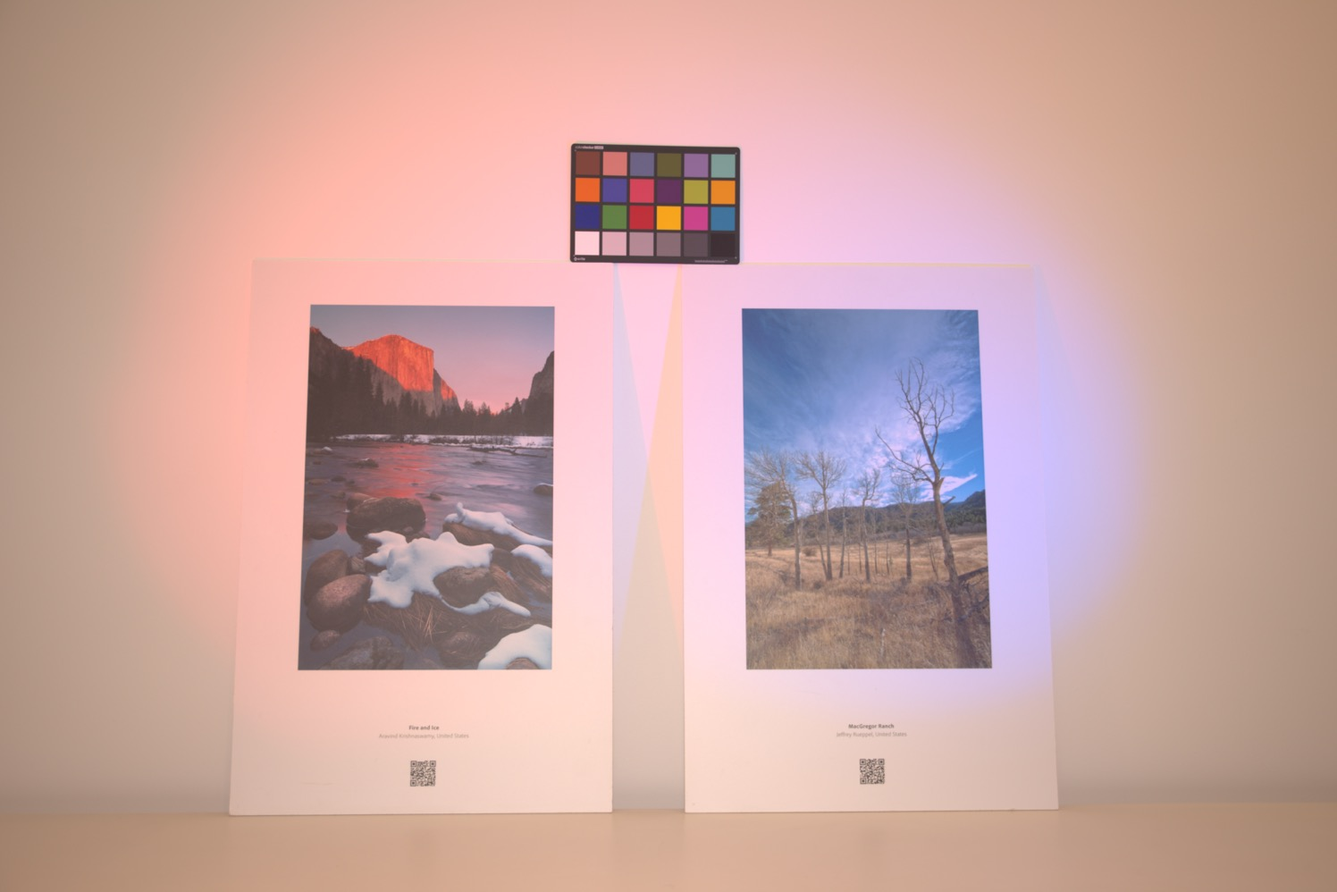
Flash/no-flash photography
Notes:
Now, we ask the following question: can we do it automatically by taking one more photograph under flash lighting.
%
People refer this kind of technique as flash photography .
%
And it is also very easy to take flash photography because most of the cameras have flash.
%
It is not a complicated hardware change and it can be accessible for most of the common users.

Slide 8

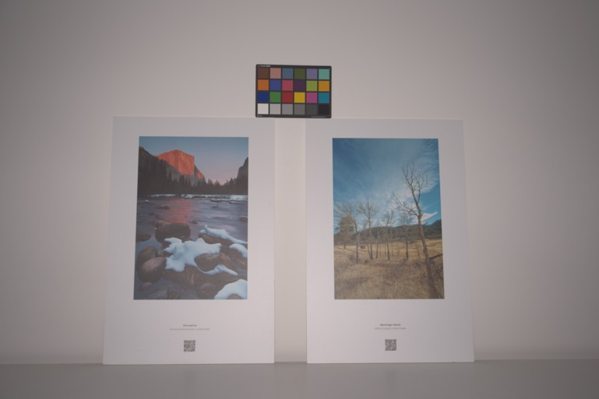




No-flash image $I_{nf}$
Difference image $d$
Flash image $I_{f}$

Slide 9

Image formation
Assumption: flash color is known
Difference image
Difference image
(flash color)
Chromaticity of albedo
Notes:
Now, if we know the flash color and this can be acquired via the calibration,
%
we can divide the difference image by the flash color.
%
What we get is the image without any light colors.
%
That is, the color of the resulting image is purely depends on the color of the reflectance.
%
By taking the chromaticity, it gives us the chromaticity of the reflectance .
%
As shown here, the identity shows the color of the reflectance and enables us to solve for the white balance kernel.

Slide 10


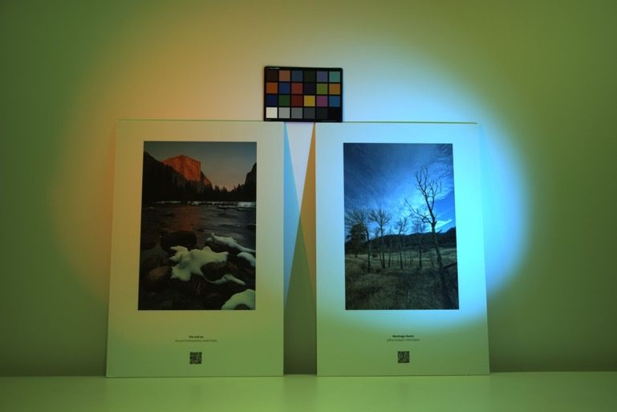



Chromaticity of albedo
$$C_{R}$$
$$C_{R}^{c}\left(p\right)=W^{c}(p)C_{nf}^{c}\left(p\right)$$
Chromaticity of no flash
$$C_{nf}$$
Notes:
In particular, we can compute the chromaticity of no flash
%
We also have the chromaticity of reflectance.
%
And we can show that the
%
At this stage, we make no assumptions on the number of lights, illuminant colors or any other knowledge of the geometry of the scene, what we have is a per-pixel solution for the arbitrary number of light sources.
%
And this is something the hallmark of our approach.

Slide 11
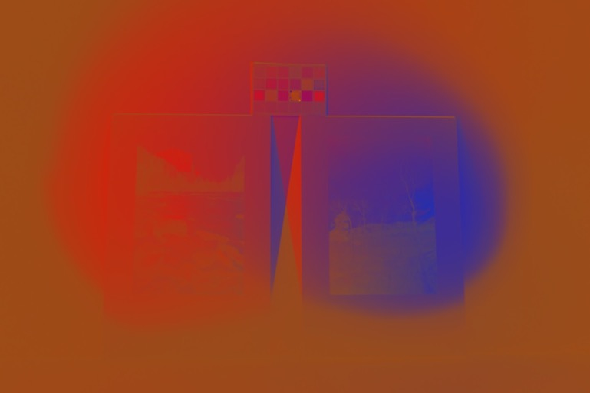
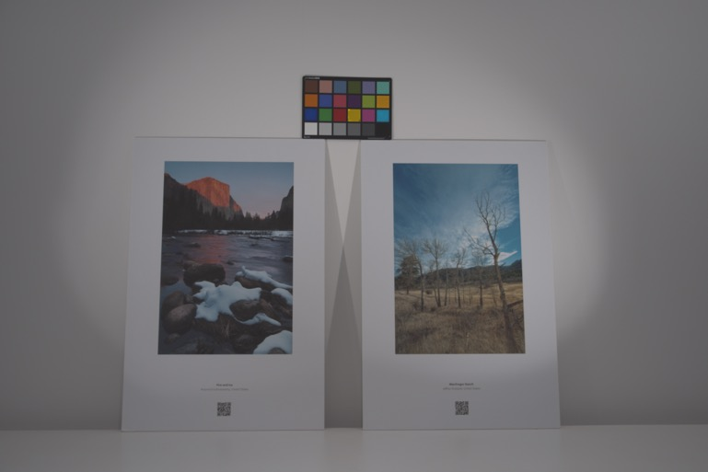
Chromaticity of albedo
$$C_{R}$$
$$C_{R}^{c}\left(p\right)=W^{c}(p)C_{nf}^{c}\left(p\right)$$
Chromaticity of no flash
$$C_{nf}$$
Notes:
In particular, we can compute the chromaticity of no flash
%
We also have the chromaticity of reflectance.
%
And we can show that the
%
At this stage, we make no assumptions on the number of lights, illuminant colors or any other knowledge of the geometry of the scene, what we have is a per-pixel solution for the arbitrary number of light sources.
%
And this is something the hallmark of our approach.

Slide 12

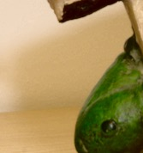
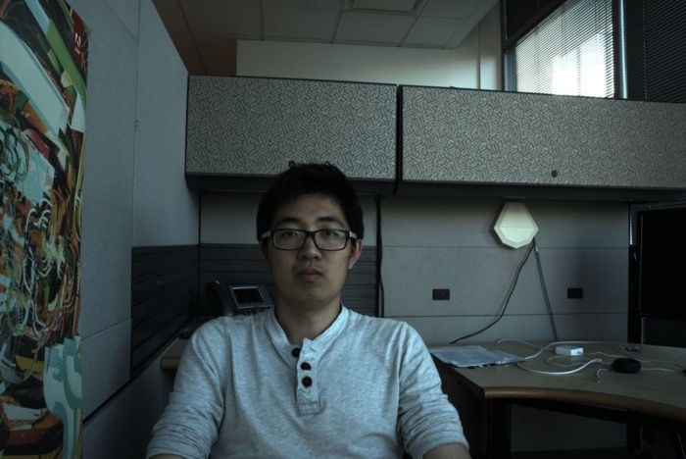
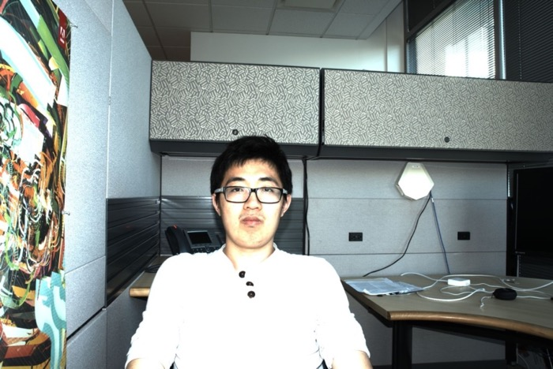
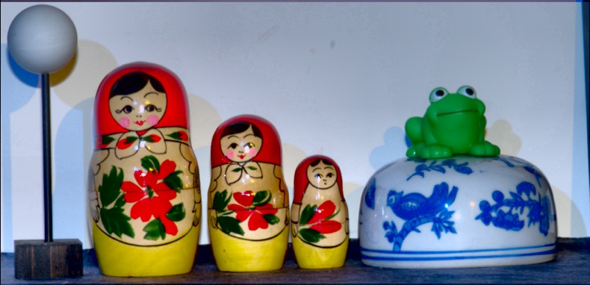

Shadows
Motions
Specularities
Notes:
For instance, flash lighting may introduce shadows as well as specularities, which violate the Lambertain assumpion.
%
But here the shadows and specularities only present in the no-flash image will not cause any issues.
%
since our model is based on per-pixel operation and shadows/specularities can be treated as one light missing or saturated.
%
I will detail this later in the results part.
%
So, here we only detect the shadows and specularities introduced by the flash lighting.
%
In addition, flash/no-flash images may not be well aligned due to both the camera and scene motions.
%
What do we do to handle these effects?
%
%Here, I am going to describe simple heuristics to address these issues. One thing I would like to point out here is, the shadows and specularities present in the no-flash will not cause any issues.
%

Slide 13

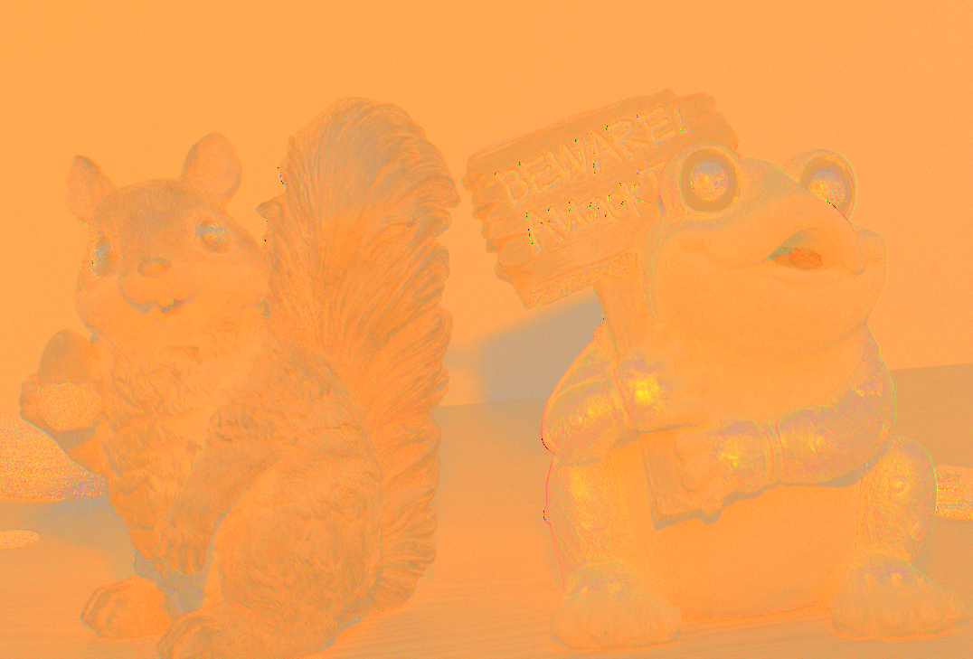
Flash image
White balanced kernels
Notes:
We come up with a simple idea is as follows:
%
We initially compute the white balance kernel as we have proposed.
%
Next, we detect the wrongly estimated regions in the white balance kernel and use their neighbors to interpolate the corresponding values.
%
To see this more clearly, lets look at this example.
%
It is the flash image captured.
%
Clearly, the flash lighting introduce the shadows on the background, which lead to the artifacts in the white balanced kernels
%
%
But the question here is how to detect wrongly estimated regions.

Slide 14
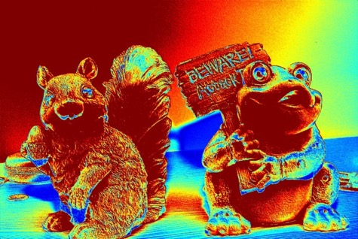
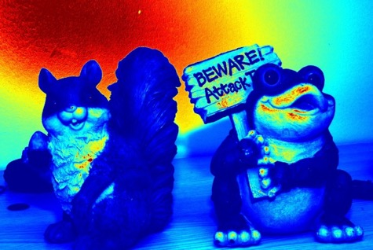
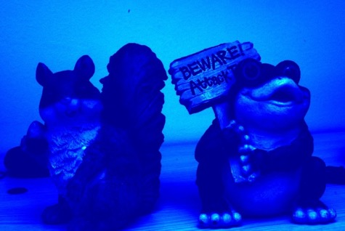
Shadow/specularity detection
Relative difference:
Shadow
Specularity
Magnitude of difference image
small
large
Magnitude of no flash image
Flash energy:
small
large
Magnitude of flash image
No flash energy:
not too large or too small
Magnitude of no-flash image
Notes:
Now we have the interpolation scheme, the rest is to detect wrongly estimated regions.
%
The idea here is shadow regions trend to contribute very small difference, but specularities reflect as large changes.
%
Lets first look at the shadow and specularity detection.
%
We achieve this by using three metrics.
%
The first metric measures the relative difference in flash/no-flash pair.
%
%The motivation here the shadows/specularities brought by the flash
%
We also come up with flash energy to help in the detection.
%
So, we can expect these two metrics to be very small in flash shadows and very large in the in flash specularities.
%
From the figures shown here, it is clearly to observe that flash shadows are with small values, as indicated by the blue color.
%
Finally, as we have mentioned before, we only detect the shadows and specularites introduced by the flash lighting.
%
To enable this, we restrict the no flash energy, being not too large or too small.
%

Slide 15



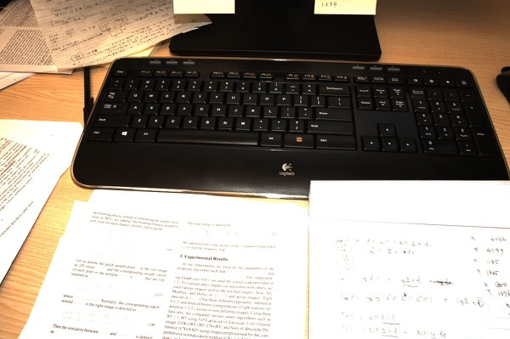
Camera motion
SIFT + RANSAC
Notes:
For the motion part, we consider two kinds of motions.
%
One caused by the camera movement and the other by the objects in the scene.
%
Lets first look at the camera motion.
%
This kind of motion can be well addressed by using rigid alignments.
%
So, we extract SIFT features and compute the homography model using RANSAC.
%
As shown here, the initial input pairs can be well aligned by using the matching scheme.
%
After aligning the input pairs, we compute the white balance kernel as what we have done before.

Slide 16




Slide 17



Scene motion
Backward flow
No flash
$${(u}_{b},v_{b})$$
Warped no flash
Flash
Forward flow
$${(u}_{f},v_{f})$$
Notes:
But what do we do if the objects in the scene have also moved as the example shown here.
%
People always refer this kind of motions as non-rigid motion and it is still an open problem.
%
Here, we come up with a simple heuristic.
%
We first align the no-flash/flash images via rigid alignment and compute the initial white balance kernels.
%
Similar to shadow/specularity compensation, we detect the wrongly estimated regions and use the white balance interpolation to correct them.
%
Here, we use forward and backward SIFT flow to detect non-rigid motions.
%
In particular, we first do the forward flow for the rigidly aligned no-flash and flash images.
%
Given the motion vectors denote here, we get the warped no flash image.
%
We use the warped image to compute the backward flow with respect to the no-flash input.
%

Slide 18
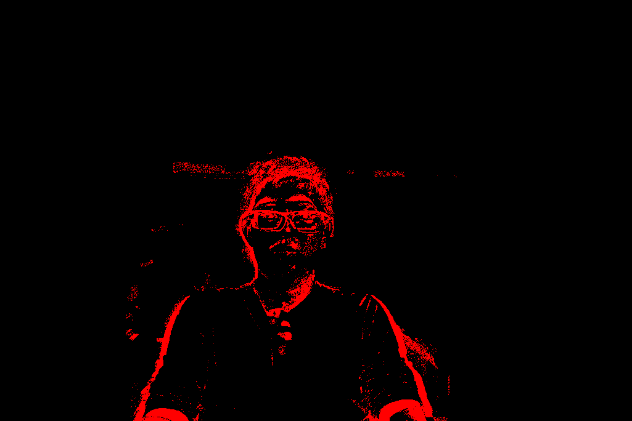
Scene motion
$${T_{F}(p)= \left\|u_{f}\left(p\right)+u_{b}(p)\right\|}_{2}^{2}+{\left\|v_{f}\left(p\right)+v_{b}(p)\right\|}_{2}^{2}$$
No flash
Detected motions
Notes:
Now, given the motions by both the forward and backward flows, we introduce the metric to detect the non-rigid motions.
%
The idea here is, the values appear to be large for the pixels underwent non-rigid motions and close to zero for the pixels that have already aligned.
%should be close to zero for the pixels that are already well-aligned.
%
And the pixels underwent scene motion are expected to be large here.
%
And we can threshold Tf to detect these regions as shown here.
%
After that, we use interpolation to fill the values in these regions.

Slide 19
Real-world tests
Notes:
To evaluate our method, we compare the performance of our technique with the state of the art methods on the real life scenes,
%
%
First, let me show the results on some real life scenes.

Slide 20
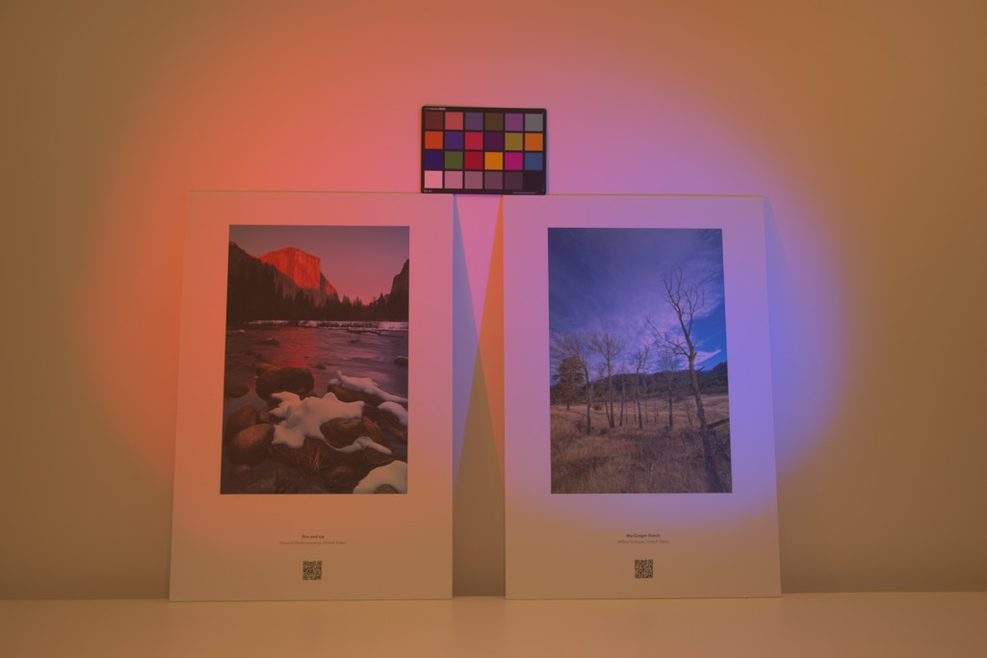
No flash
spatially varying lights
Notes:
Now lets look at this scene.
%
To quantitatively evaluate the performance, we place the color checkborad in the scene.
%
We measure the angular difference between the white color observed on the color-checker chart to true white color.
%
Here, I am showing the input no-flash image.
%
Clearly, we can observe the nature of the mixture of illuminations.

Slide 21
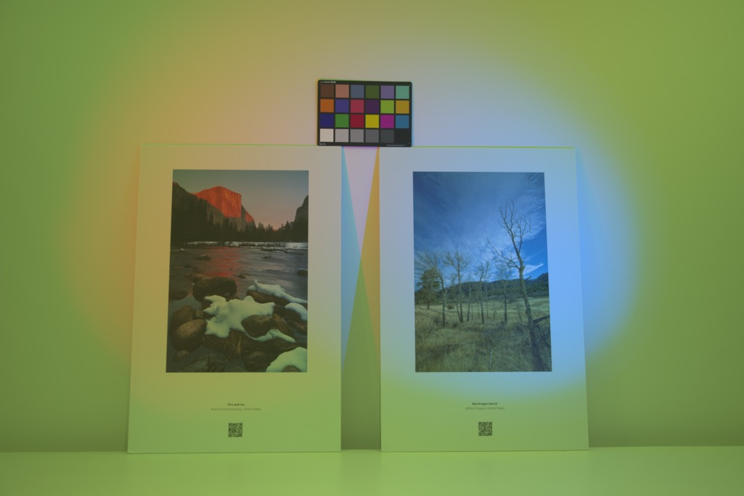
Results
Assumption:
single dominant light
Lambertian scene
Input:
single image
Output:
single light color
Angular error:
35.49◦
Gijsenij et al., Improving color constancy by photometric edge weighting, PAMI, 2012
Notes:
We first compare with the method based on single dominate light assumption.
%
As observed, from both the visually quality and the angle error measured (as indicated in the parentheses), the single dominate light assumption cannot well address the problem for the mixed lighting condition.

Slide 22
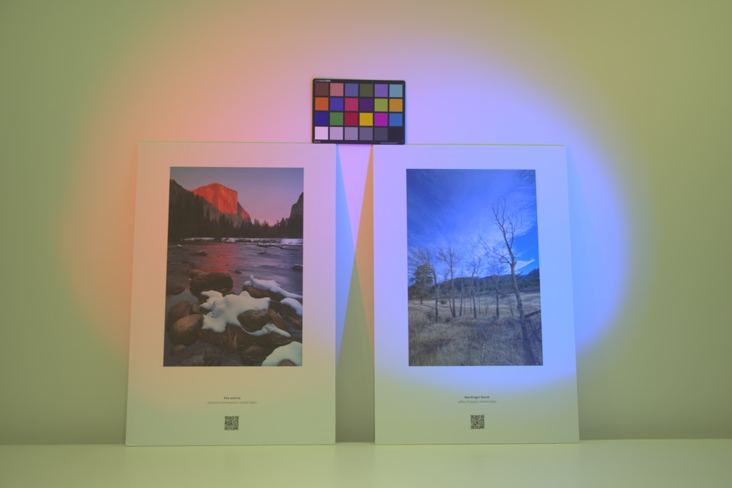
Results
Assumption:
single dominant light
Lambertian scene
known flash color
Input:
flash/no flash
Output:
single light color
Angular error:
14.74◦
Petschnigg et al., Digital photography with flash and no-flash image pairs, TOG, 2004
Notes:
Now, lets look at another method also build upon single light assumption but using flash/no flash input pairs.
%
The results are much better since more constraints can be incorporated by the extra flash image.
%
But, restricted by the single light model, it still tries to remove the average color of all the light sources.

Slide 23
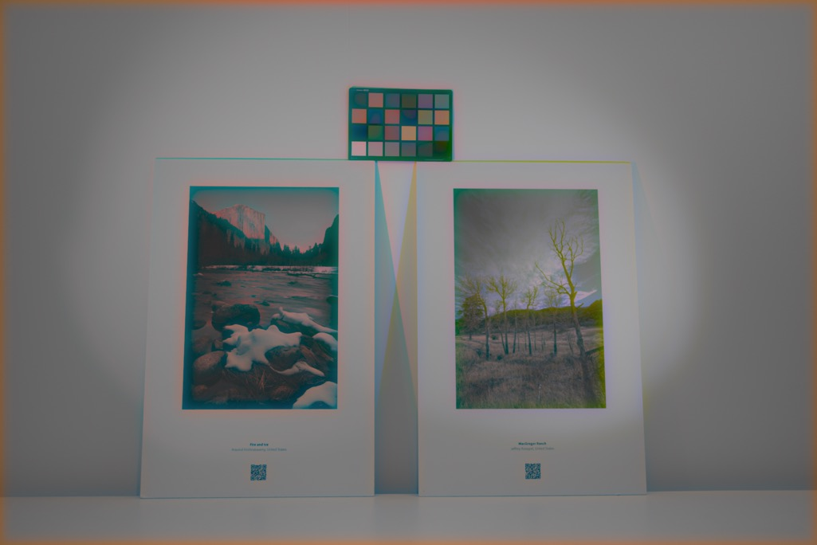
Results
Assumption:
Lambertian scene
Input:
single image
Output:
spatially varying light colors
Angular error:
0.19◦
Ebner, Color constancy using local color, ECCV, 2004
Notes:
Here, I am showing the method proposed by ebner, which does mask any assumptions on the number of illuminants.
%
In this method, an orthogonal color is computed from a local patch, and they treated it as the colors introduced by the light source..
%
While it produces good results in angle error measurement, it leads to the washed out colors in the visual quality.

Slide 24
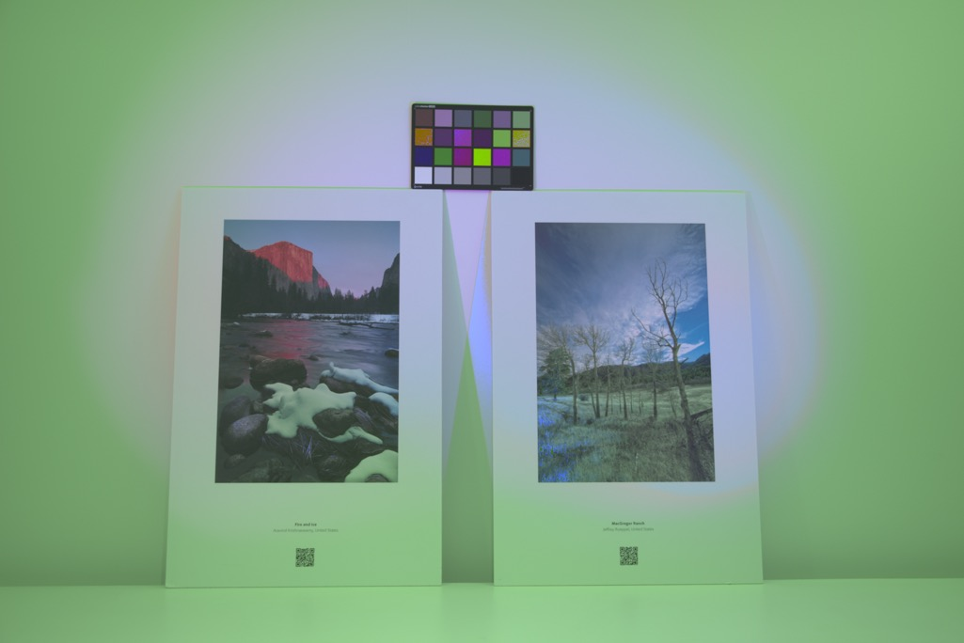
Results
Assumption:
two lights
Lambertian scene
Input:
single image
known light color
Output:
spatially varying light colors
Angular error:
10.89◦
Hsu et al., Light mixture estimation for spatially varying white balance, TOG, 2008
Notes:
The method focuses on solving the spatially varying illuminations with two lights.
%
The method assumes the only two light sources present in the scene and their colors are known.
%
The scene we shown here consists of more than two light sources and the method fails to produce good results.

Slide 25

Results
Assumption:
Lambertian scene
known flash color
Input:
flash/no-flash
Output:
spatially varying light colors
Angular error:
0.88◦
Notes:
In contrast, our approach returns best results in terms of visual quality and good angular error measurement.
%
This is attributed to the closed form solution obtained for arbitrary number of lights.

Slide 26

No-flash
Mixture of outdoor and indoor illuminants

Slide 27
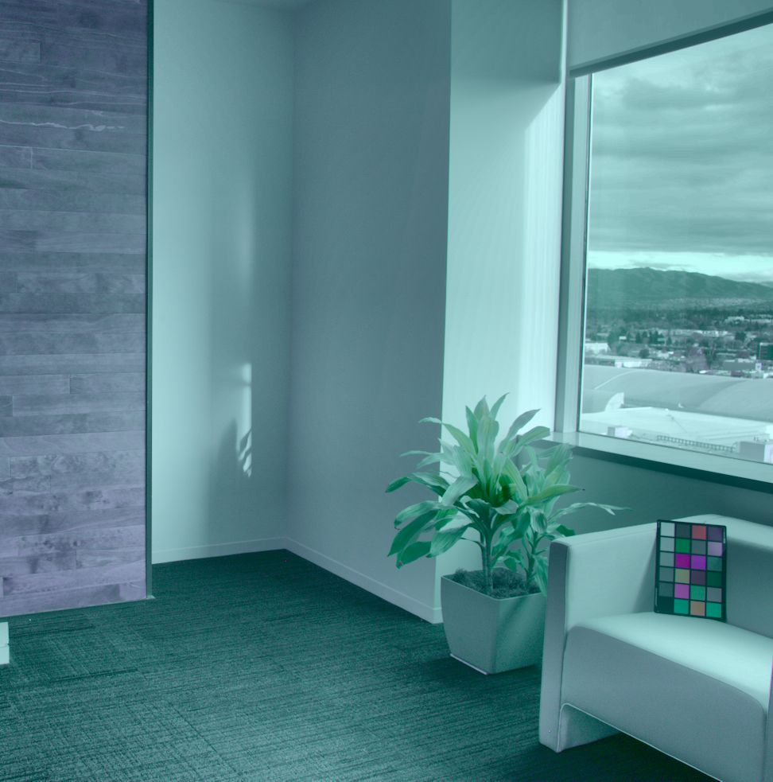
Results
Assumption:
two lights
Lambertian scene
Input:
single image
known light color
Output:
spatially varying light colors
Angular error:
20.51◦
Hsu et al., Light mixture estimation for spatially varying white balance, TOG, 2008

Slide 28

Results
Assumption:
Lambertian scene
known flash color
Input:
flash/no-flash
Output:
spatially varying light colors
Angular error:
1.18◦

Slide 29
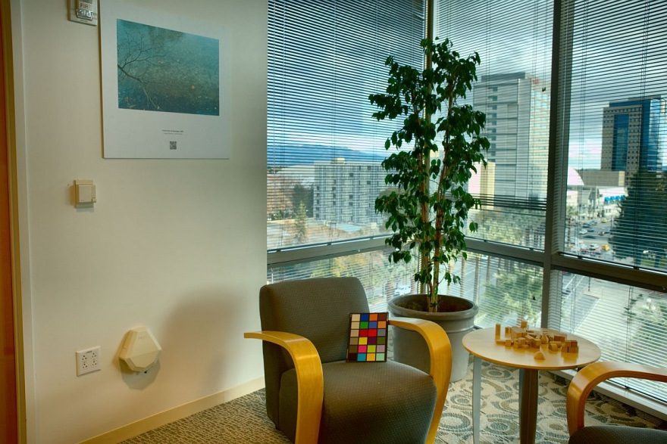
No-flash

Slide 30
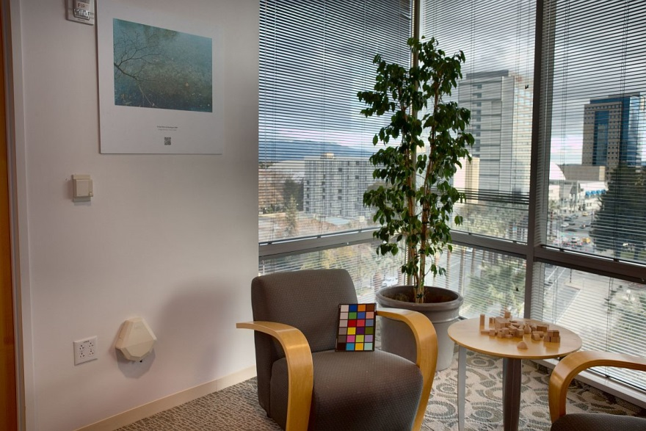
Results
Angular error:
1.59◦

Slide 31

No-flash

Slide 32

Results
Angular error:
0.12◦

Slide 33
Shadows/specularities
Notes:
Next, lets look at the ability of our approach in handling shadows and specularities.

Slide 34



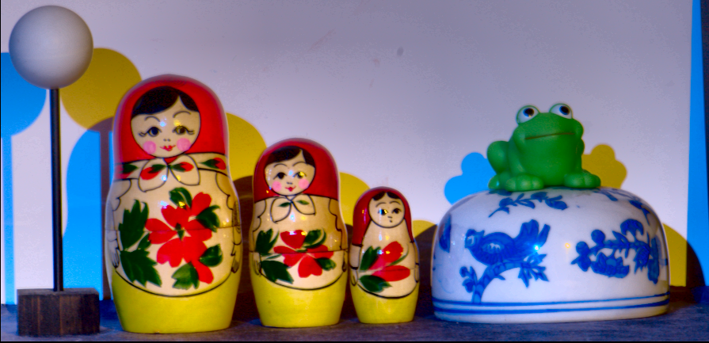
No flash
Notes:
Here is the scene we would like to test.
%
You can see large depth discontinuities in the scene and objects with glossy reflectances..
%
I would like to point out that, this scene also has cast shadows and specular highlights caused by the scene illumination, and you can see these effects clearly by these close-ups.
%
But, as I will show in the next few slides, these effects will not cause any issues to our approach.

Slide 35



Flash
Notes:
When we shot flash lighting in the scene, objects in the foreground cast shadows on the background as well as introduce small specular highlights.
%
As shown in these close-up image.

Slide 36



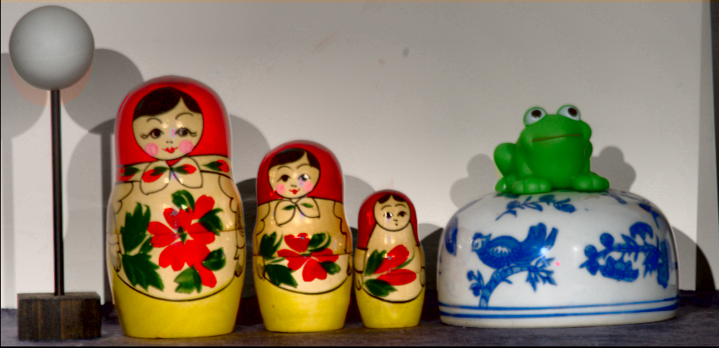
Initial white balance results
Notes:
The introduced shadows and specularities by the flash will lead to the artifacts in the white balanced results.
%
But the our model is not affected by the shadows and specularities brought by the scene illumination.
%
This is attributed to the per-pixel nature of our proposed model and shadows in the no-flash can be simply treated as the light sources missing.

Slide 37



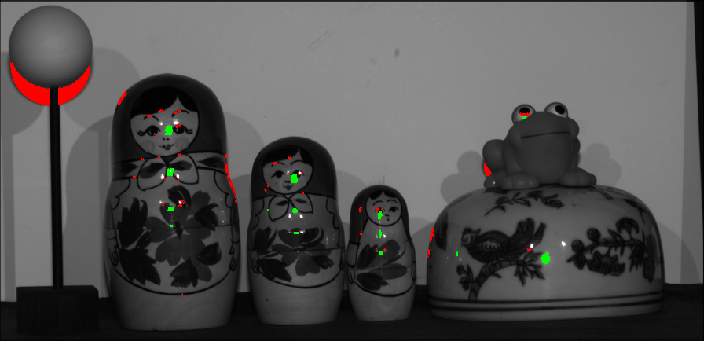
Detected shadow/specular
Notes:
We detect the shadows and specularities by using our proposed scheme.
%
The red regions denote the detected shadows, and green one denotes the specularities.
%

Slide 38




Shadow/specular removal results
Notes:
After detection, we use interpolation scheme to correct them. Finally, we can produce artifact free results.

Slide 39
Camera and scene motion
Notes:
Now, I am showing the results in handling the motions.

Slide 40

No flash
Notes:
This scene is with both camera and scene motion between.

Slide 41

Flash
Notes:
And you can clearly see this from the input flash/no-flash input pairs.

Slide 42


Slide 43
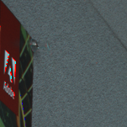
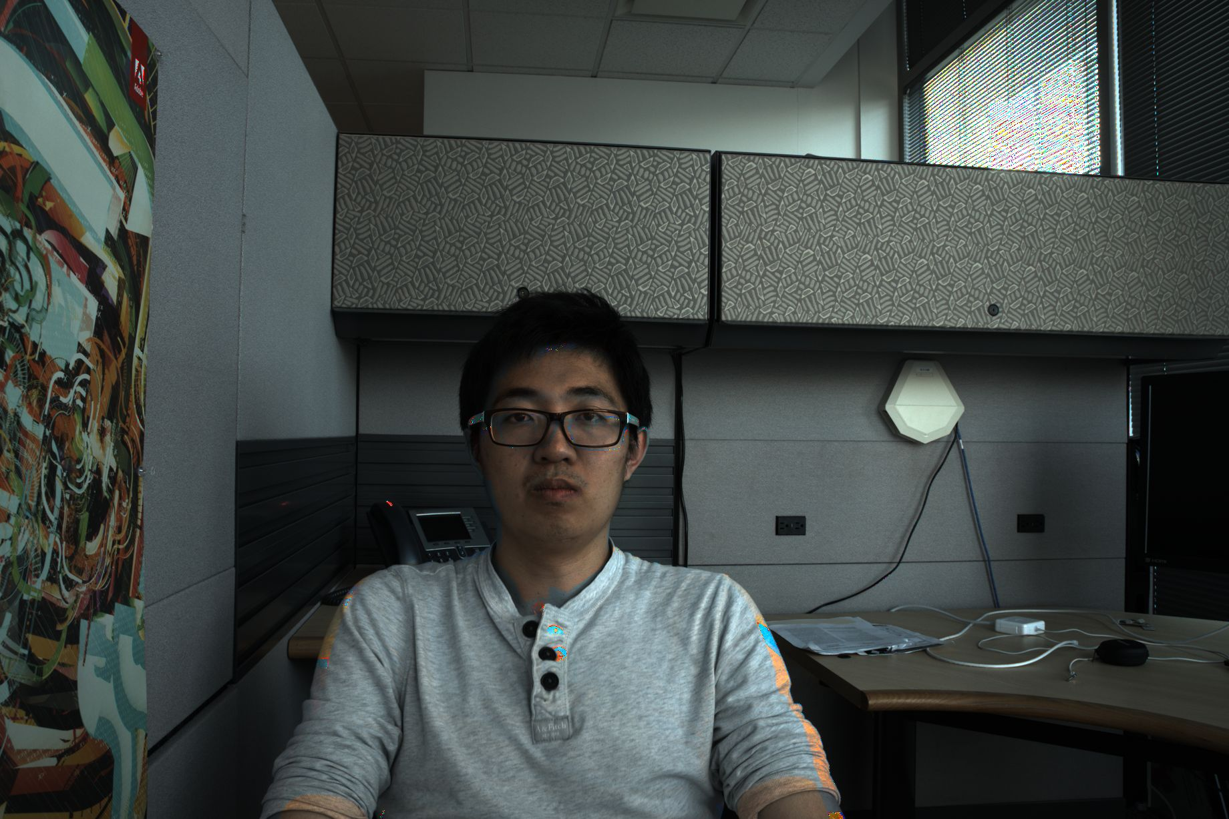


Initial white balance results
Notes:
Directly applying the proposed white balance scheme will lead to artifacts.
%As indicated by these close-up looks

Slide 44

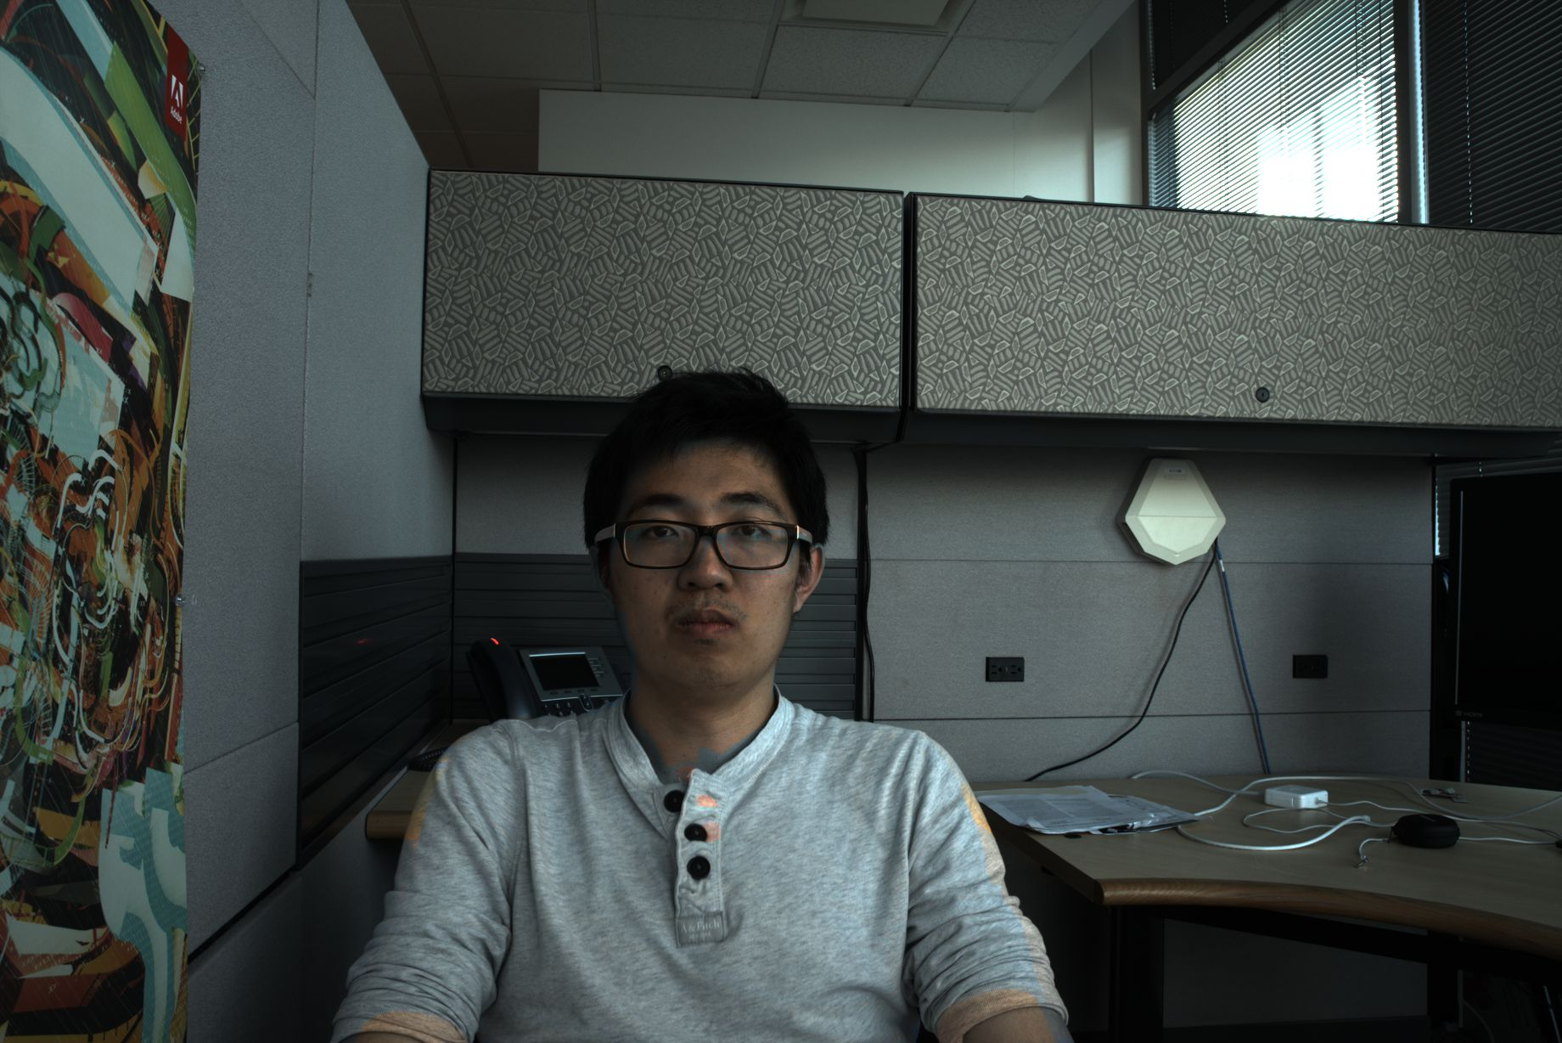


With rigid alignment
Notes:
We first align the flash/no-flash pairs via rigid alignment.
%
As observed from the close ups, the artifacts near edges can be eliminated.
%
But the artifacts are still there for pixels underwent non-rigid motion

Slide 45




With non-rigid compensation
Notes:
We detect them via the metric leveraging forward and backward flows, and correct them using the interpolation scheme.
%
We observe that most of the artifacts can be removed and it can produce visually pleasing results.

Slide 46
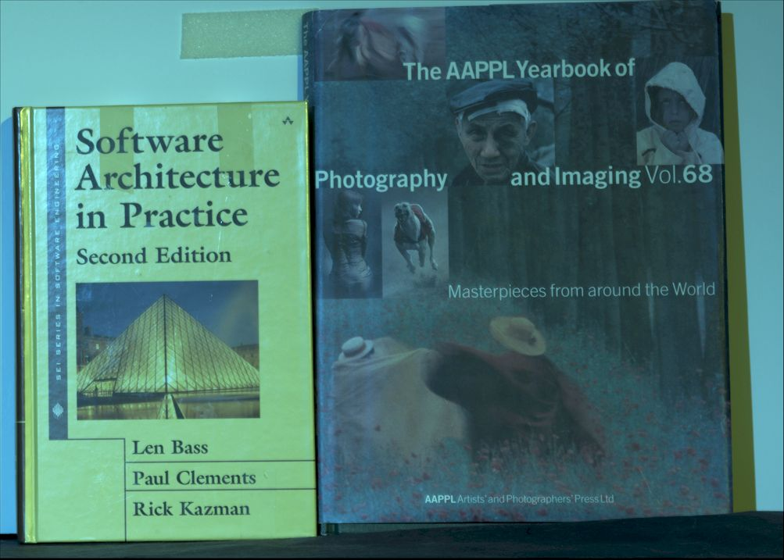
No flash
Notes:
While we come up with compensation scheme to address the model violations, there still are certain cases the proposed technique may fail.
%
For instance, our model may fail for the scene with large regions of specularities.
%
Lets look at this example.
%
Here, I am showing the input no-flash/flash input.

Slide 47
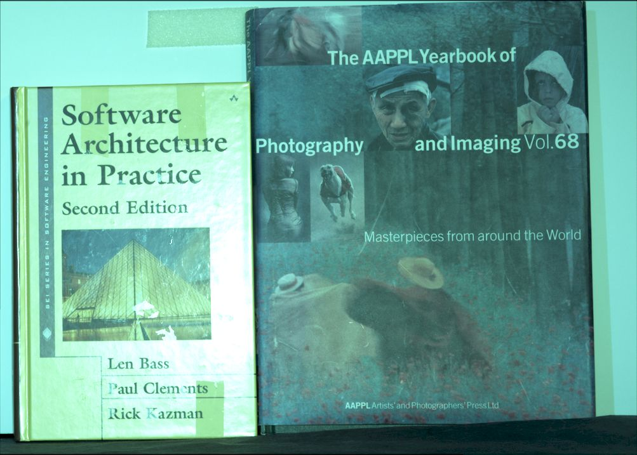
Flash
Notes:
Clearly, we can observe the flash lighting introduces large regions of specularities.

Slide 48
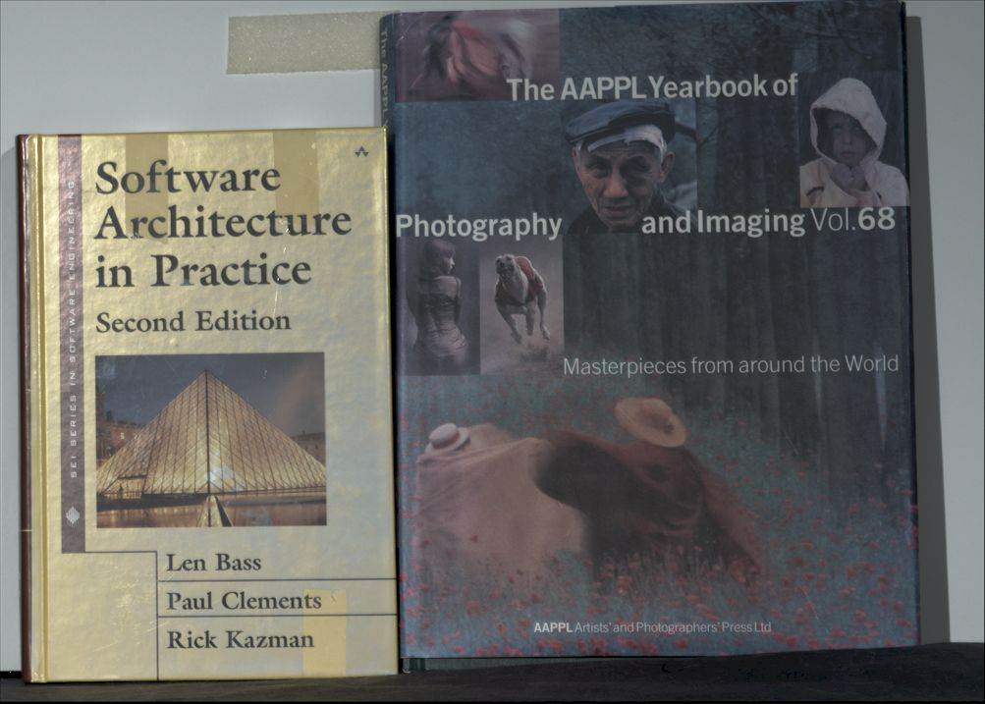
White balanced results
Notes:
Which lead to the artifacts that cannot be well addressed by using our scheme.

Slide 49
Limitations
Fails in large violations of the Lambertian scene
Requires the linear response data
Produces noise estimates for large distance to the camera
Notes:
Besides that,
%
Our approach is built upon the linear response data.
%
And it assumes that all the scene points can be illuminated by the flash light.
%
This may produce noise estimates for the scene with large distance.
%
We may work on these stuffs in the future to make our approach even more flexible for practical implementations.

Slide 50
Summary
White balance with flash photography
Automatic, per-pixel and closed form solution
Notes:
In summary, what we have is flash photography approach applying to white balance problem under mixture of lighting conditions.
%
The key assumption we make is the Lambertain scene and known flash color.
%
In return, the ability we have enabled is an automatic framework with per-pixel closed form solution for arbitrary number of light sources.

